Slide 1






Foundations of
Quantum Information Science (QIS 102)
Dave Biersach
Brookhaven National Laboratory
dbiersach@bnl.gov
Session 06
Data Visualization

Slide 2
Session 06 – Part 1 of 3 – Topics
Plot 2-D equations using the Python package matplotlib and its pyplot module
Relate the pyplot figure object to its axes object, and learn how to decorate plots with titles, labels, grids, etc.
Create numpy arrays using np.linspace()
Understand vectorized operations that implicitly operate on an entire NumPy array with just one algebraic expression
Learn about LaTeX to display proper mathematical symbols
Use the SymPy package to do exact symbolic (analytic) calculus (limits, derivatives, integrals, etc.)

Slide 3
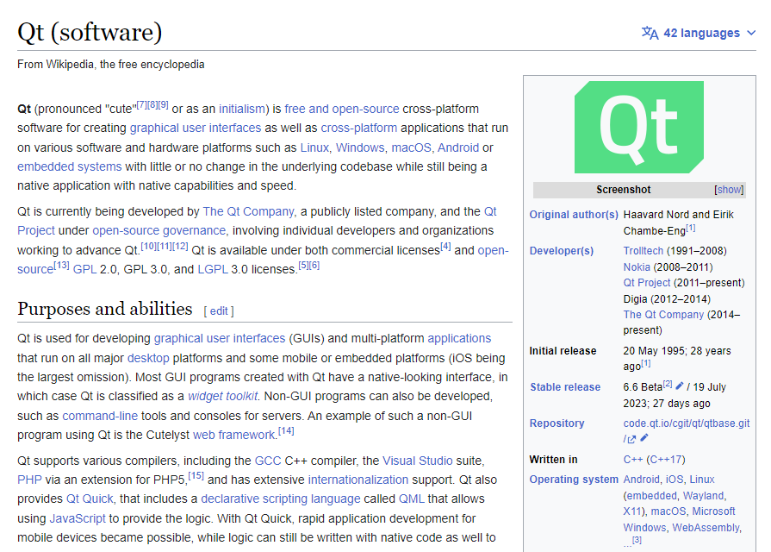
Python User Interfaces via Qt
https://en.wikipedia.org/wiki/Qt_(software)

Slide 4

Python User Interfaces via Qt6
https://www.qt.io/product/qt6

Slide 5
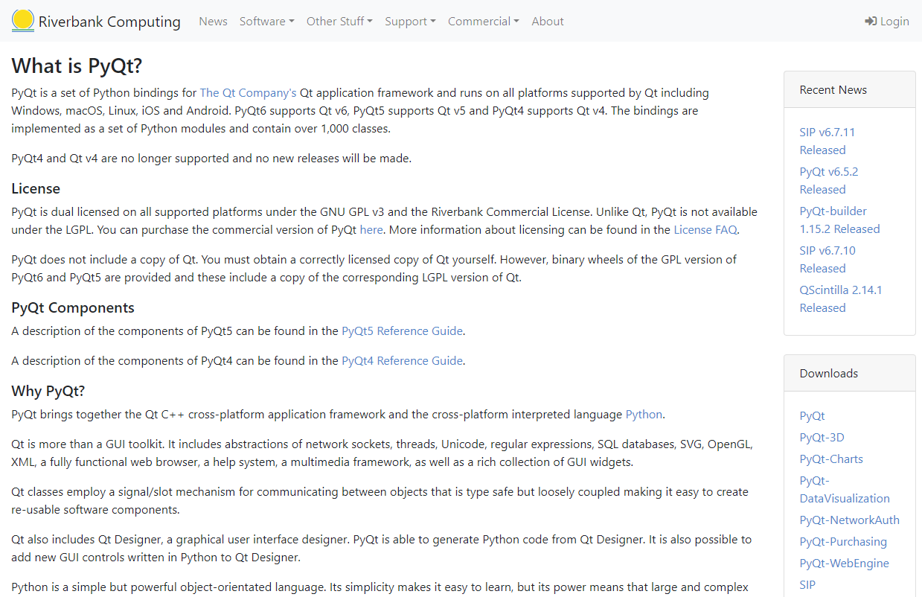
Python User Interfaces via PyQt6
https://www.riverbankcomputing.com/software/pyqt

Slide 6
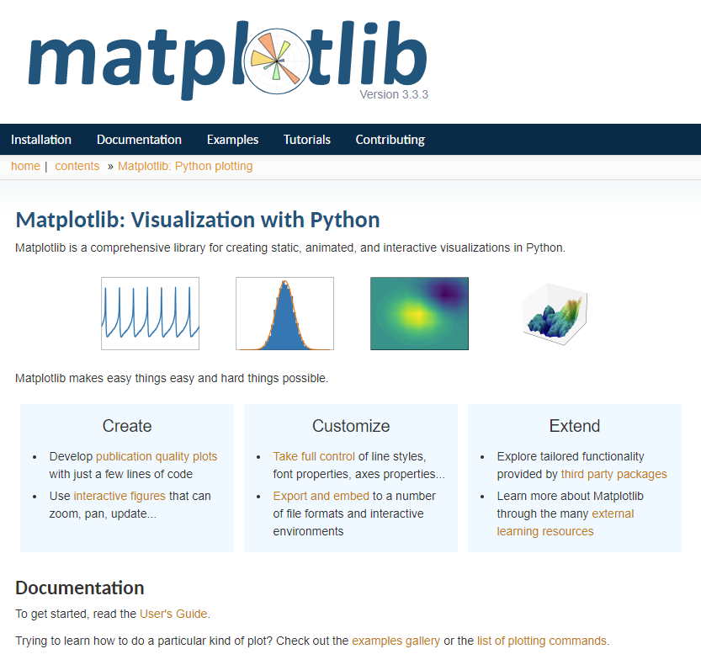
https://matplotlib.org

Slide 7
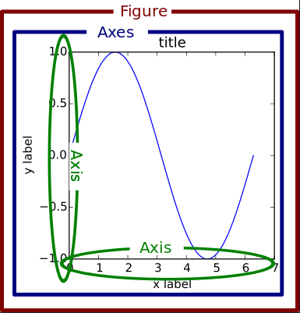
Matplotlib Container Hierarchy

Slide 8
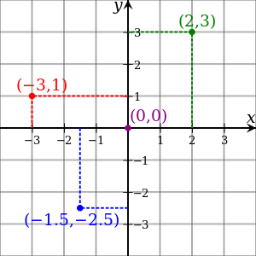
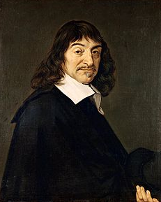
Cartesian Coordinates
Created by René Descartes in 1637

Slide 9
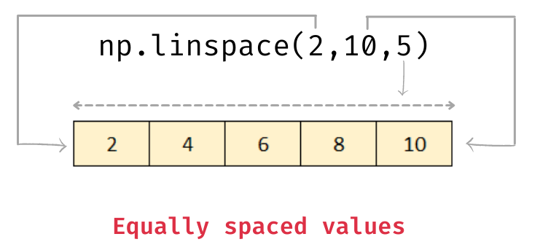
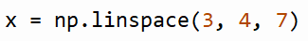
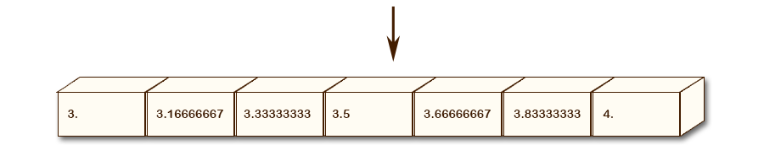
A Numpy Linearly Spaced Array
Creates a "street" of mailboxes where the values inside are equally spaced between [start, stop]
You must provide both
start and stop values!
The stop value is inclusive
Index [0]
Index [6]
np.linspace() figures out the step size based on the range of the linear space and the number of elements you request

Slide 10
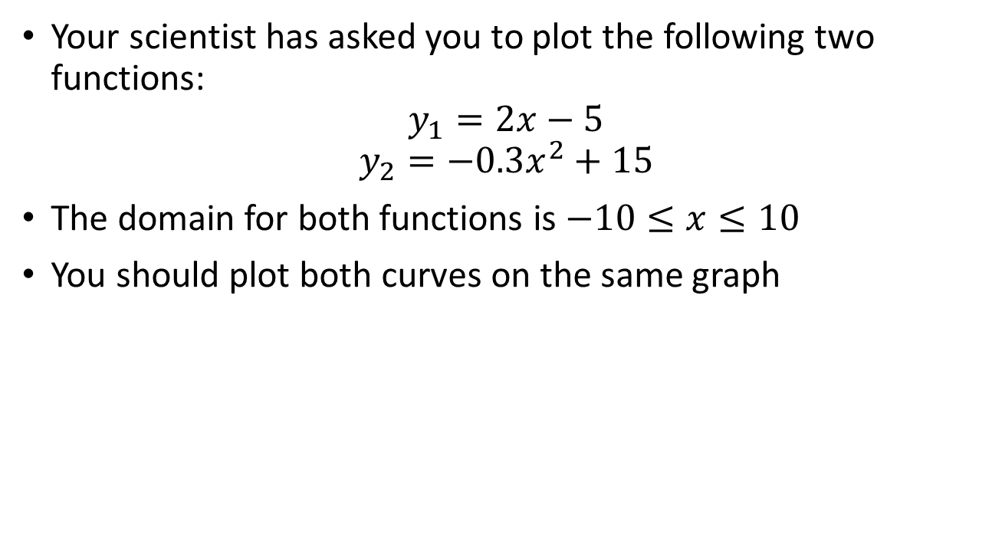
Line Graphs using matplotlib
Your scientist has asked you to plot the following two functions:
$$y_{1}=2x−5$$
$$y_{2}=−0.3x^{2}+15$$
The domain for both functions is $−10≤x≤10$
You should plot both curves on the same graph

Slide 11
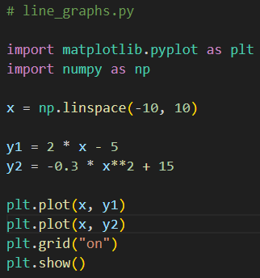
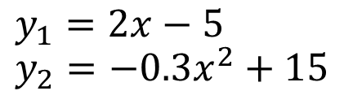
Open line_graphs.py
①
x is now an array containing 50 numbers between -10 and 10
②
③
④
⑤
y1 and y2 are now arrays containing 50 numbers
⑥
⑦
Vectorized Operations in NumPy

Slide 12
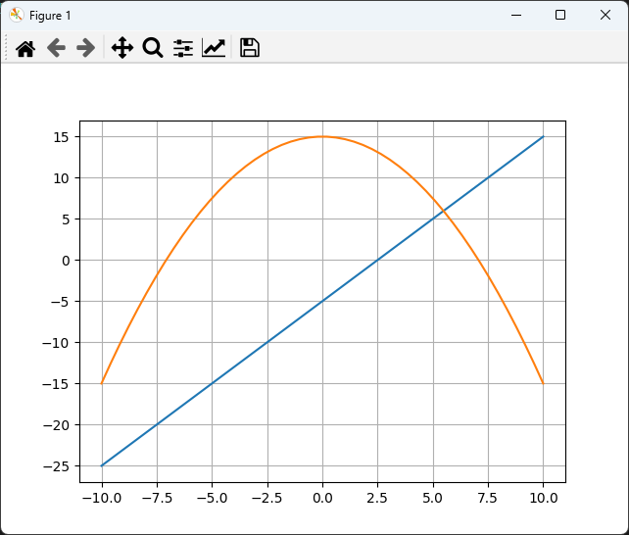
Run line_graphs.py
You must close the plot window

Slide 13
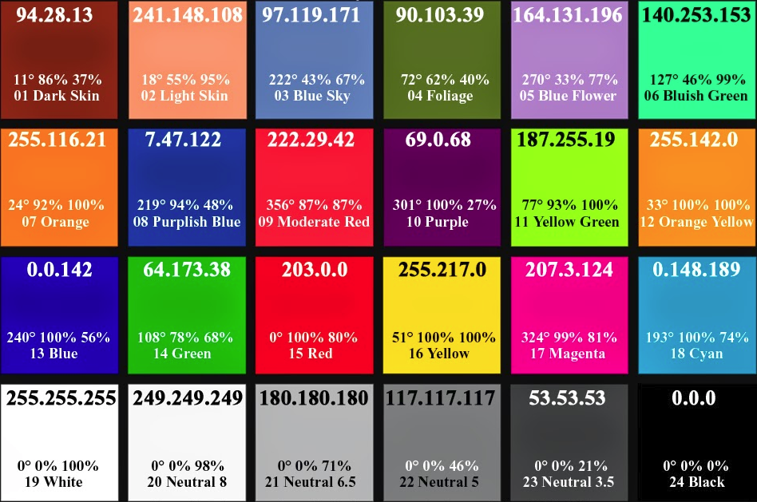
Various Colors in RGB Values

Slide 14
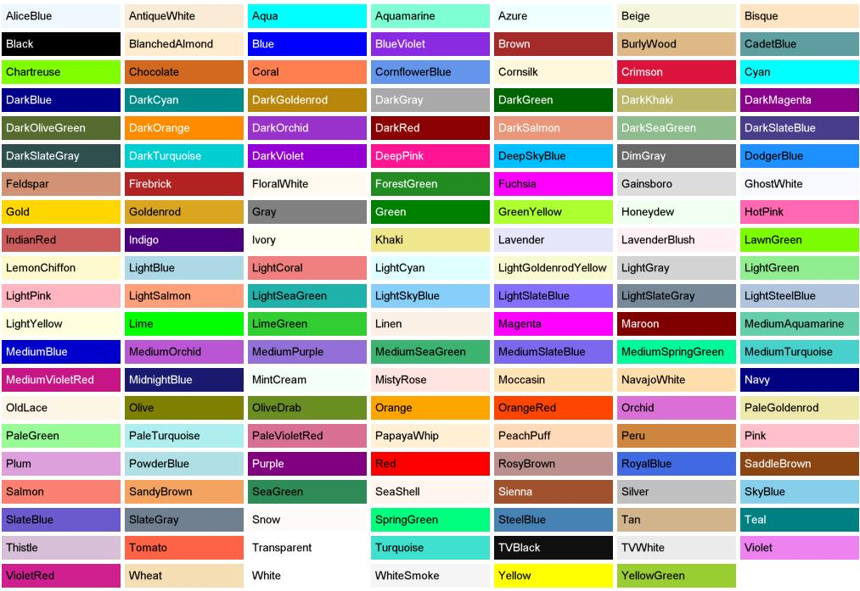
Predefined Color “Names”

Slide 15
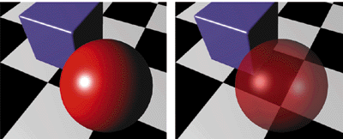
Alpha Blending = Opacity
Alpha = 0 means fully transparent (see through)
Alpha = 255 means fully opaque

Slide 16
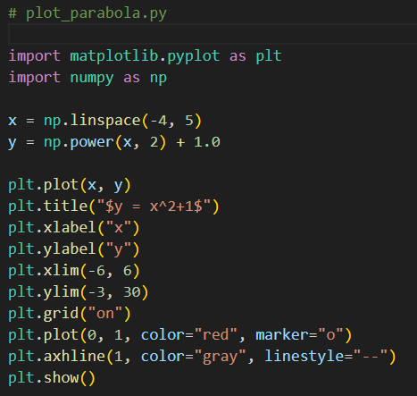

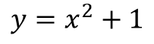
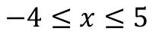
Open plot_parabola.py
①
$$y=x^{2}+1$$
②
$$−4≤x≤5$$
③
④
⑤
⑥
⑦
⑧
⑨
⑩

Slide 17
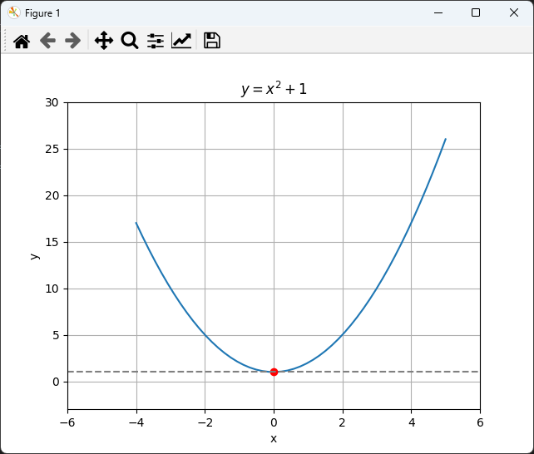
Run plot_parabola.py
You must close the plot window

Slide 18


https://www.latex-project.org

Slide 19

https://www.overleaf.com

Slide 20

https://www.overleaf.com/learn/latex/Learn_LaTeX_in_30_minutes

Slide 21

https://www.texstudio.org
100% free – runs on Windows, Mac, Linux

Slide 22
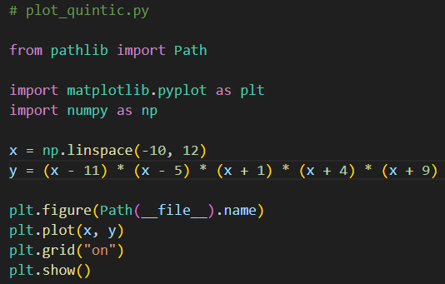
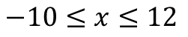
Open plot_quintic.py
$y=x^{5}−{2x}^{4}−120x^{3}+22x^{2}+2119x+1980$
$$−10≤x≤12$$
①
“dunder” = double underscore
dunder variables
dunder methods
②
③
④
⑤
⑥
⑦
https://docs.python.org/3/library/pathlib.html
https://www.pythonmorsels.com/dunder-variables

Slide 23
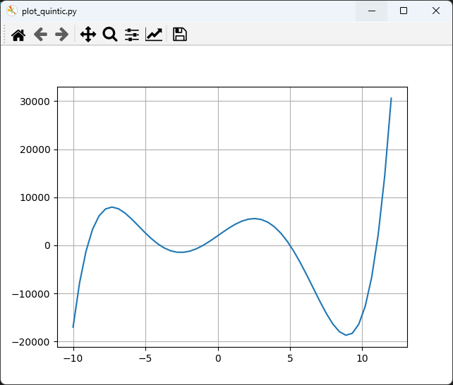
Run plot_quintic.py
①
You must close the plot window

Slide 24
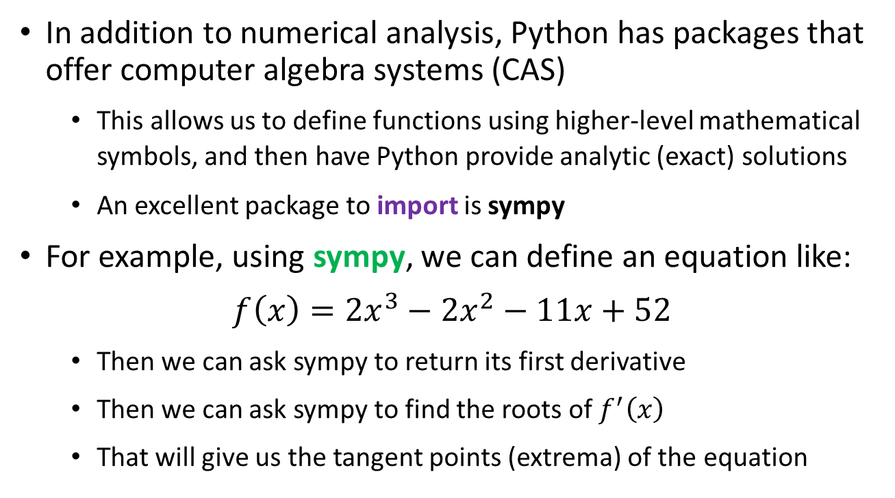
Symbolic Algebra & Calculus
In addition to numerical analysis, Python has packages that offer computer algebra systems (CAS)
This allows us to define functions using higher-level mathematical symbols, and then have Python provide analytic (exact) solutions
An excellent package to import is sympy
For example, using sympy, we can define an equation like:
$$f\left(x\right)=2x^{3}−2x^{2}−11x+52$$
Then we can ask sympy to return its first derivative
Then we can ask sympy to find the roots of $f^{′}\left(x\right)$
That will give us the tangent points (extrema) of the equation

Slide 25
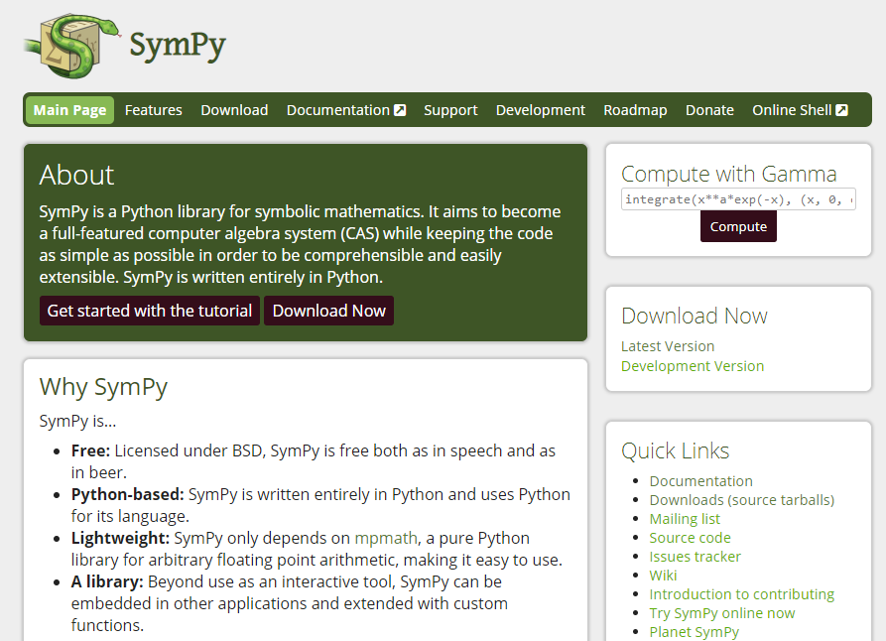
Symbolic Algebra & Calculus
https://www.sympy.org

Slide 26
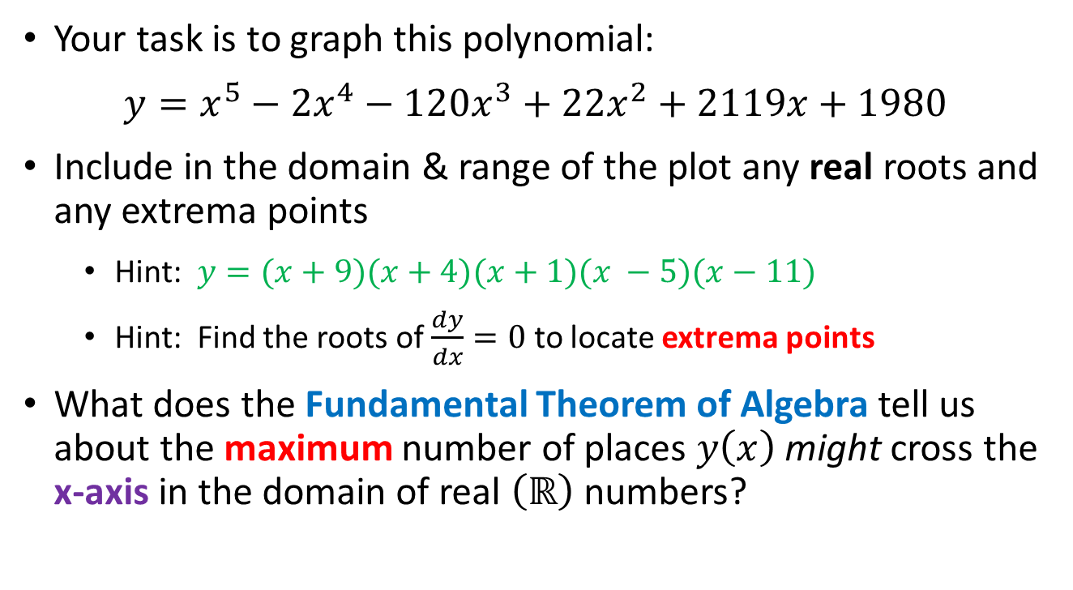
Symbolic Algebra & Calculus
Your task is to graph this polynomial:
$y=x^{5}−{2x}^{4}−120x^{3}+22x^{2}+2119x+1980$
Include in the domain & range of the plot any real roots and any extrema points
Hint: $y=(x+9)(x+4)(x+1)(x −5)(x−11)$
Hint: Find the roots of $\frac{dy}{dx}=0$ to locate extrema points
What does the Fundamental Theorem of Algebra tell us about the maximum number of places $y\left(x\right)$ might cross the x-axis in the domain of real $\left(ℝ\right)$ numbers?

Slide 27
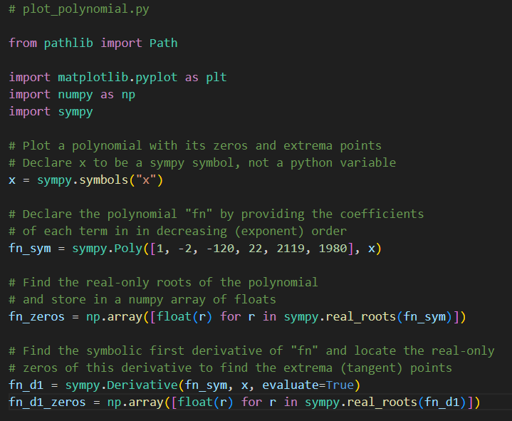
Open plot_polynomial.py
①
②
③
④
⑤
⑥

Slide 28
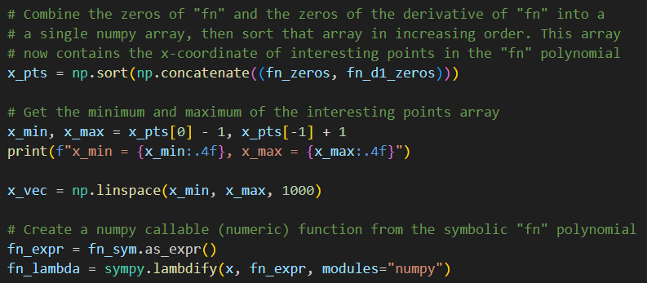
View plot_polynomial.py
①
②
③
④
⑤
⑥

Slide 29
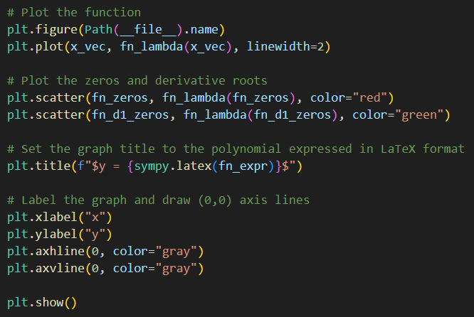
View plot_polynomial.py
①
②
③
④
⑤
⑥
⑦
⑧

Slide 30
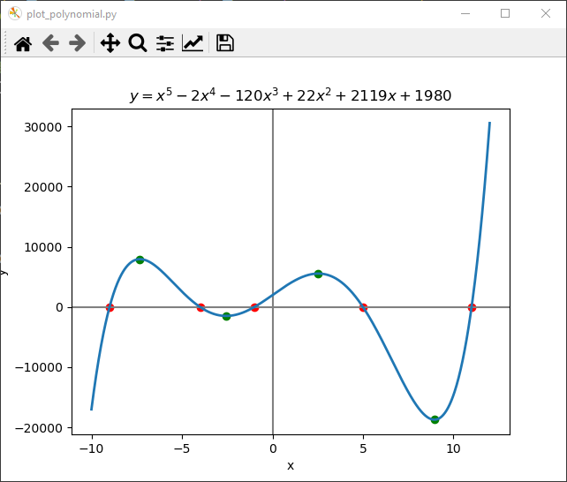
Run plot_polynomial.py
☺

Slide 31
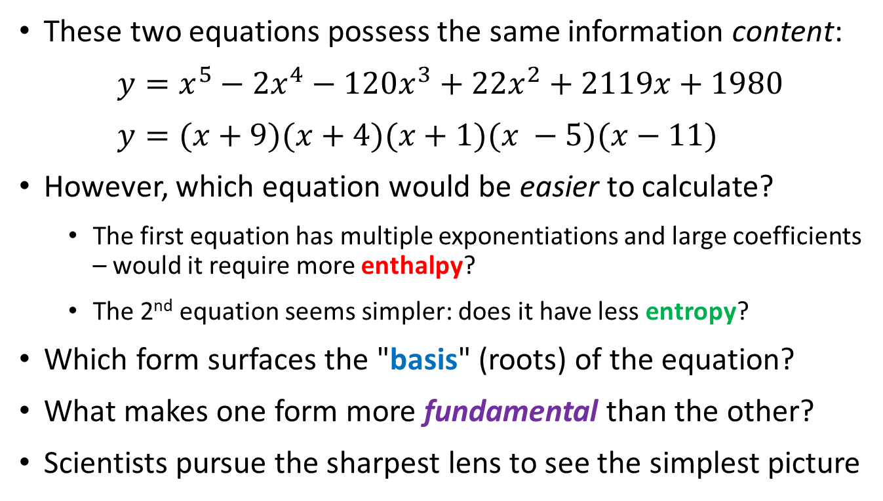
The Thermodynamics of Calculation
These two equations possess the same information content:
$y=x^{5}−{2x}^{4}−120x^{3}+22x^{2}+2119x+1980$
$$y=(x+9)(x+4)(x+1)(x −5)(x−11)$$
However, which equation would be easier to calculate?
The first equation has multiple exponentiations and large coefficients – would it require more enthalpy?
The 2nd equation seems simpler: does it have less entropy?
Which form surfaces the "basis" (roots) of the equation?
What makes one form more fundamental than the other?
Scientists pursue the sharpest lens to see the simplest picture

Slide 32
Session 06 – Part 2 of 3 – Topics
Plot parametric equations using polar graphs
Appreciate the story behind the Olympic Rings brand standard
Consider the amplitude, frequency, and phase of waves
Trace the waveform of two sinusoids in superposition
Visualize the Fahrenheit, Celsius, and Kelvin scales
Plot the divergence and convergence of the Harmonic and Basel series

Slide 33
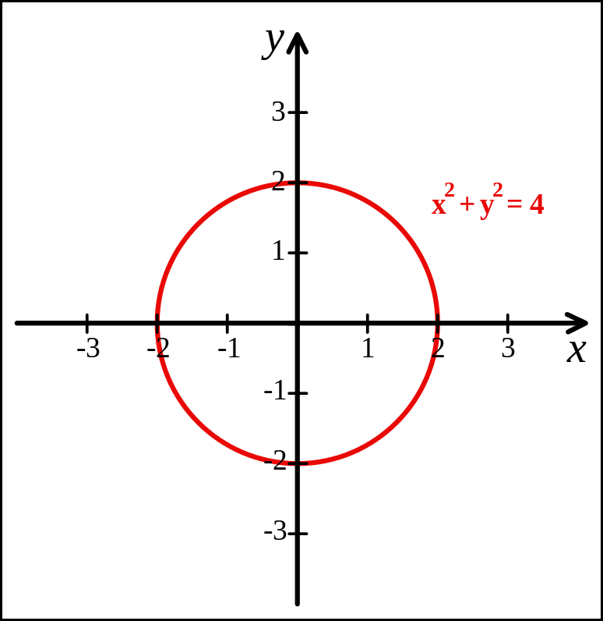
Cartesian Coordinates
Created by René Descartes in 1637

Slide 34
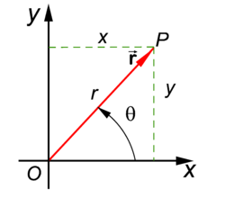
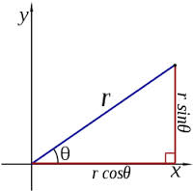
Polar Coordinates
A radius and an angle (theta)
make a 2D polar coordinate
$$(r∗\cos{θ, r ∗ \sin{θ)}}$$

Slide 35
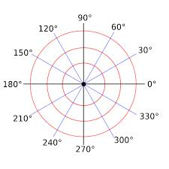
Polar Coordinates

Slide 36
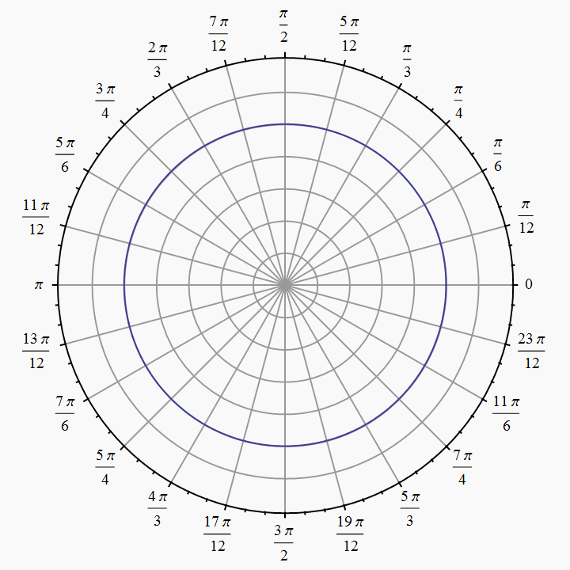
Polar Coordinates
Angles are measured in
radians
(0 ≤ θ ≤ $2π)$

Slide 37
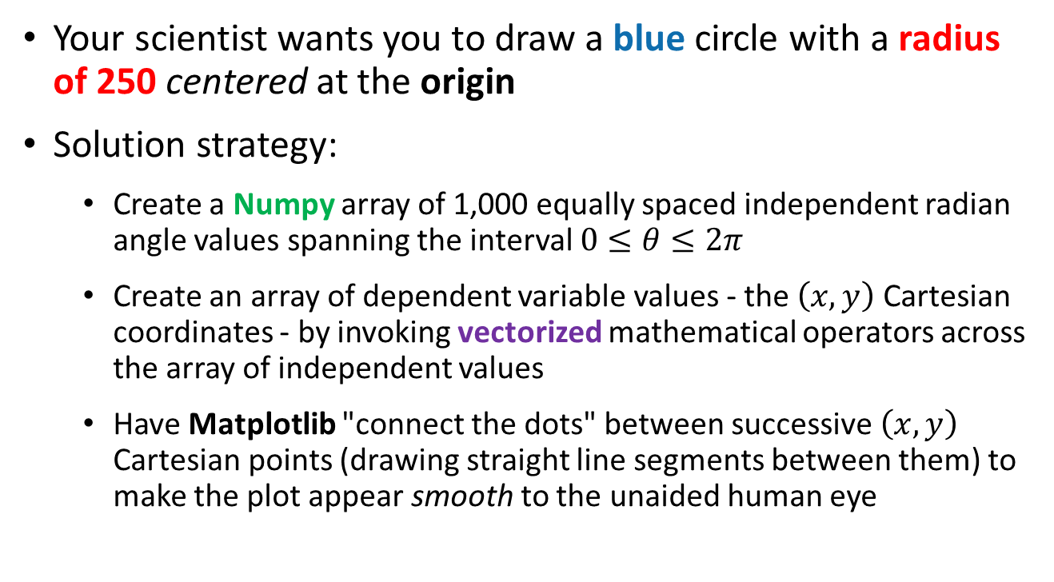
Polar to Cartesian Coordinate Conversion
Your scientist wants you to draw a blue circle with a radius of 250 centered at the origin
Solution strategy:
Create a Numpy array of 1,000 equally spaced independent radian angle values spanning the interval $0≤θ≤2π$
Create an array of dependent variable values - the $\left(x,y\right)$ Cartesian coordinates - by invoking vectorized mathematical operators across the array of independent values
Have Matplotlib "connect the dots" between successive $\left(x,y\right)$ Cartesian points (drawing straight line segments between them) to make the plot appear smooth to the unaided human eye

Slide 38
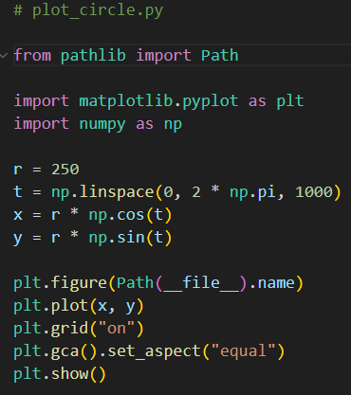
Open plot_circle.py
①
②
③
④
⑤
⑥

Slide 39
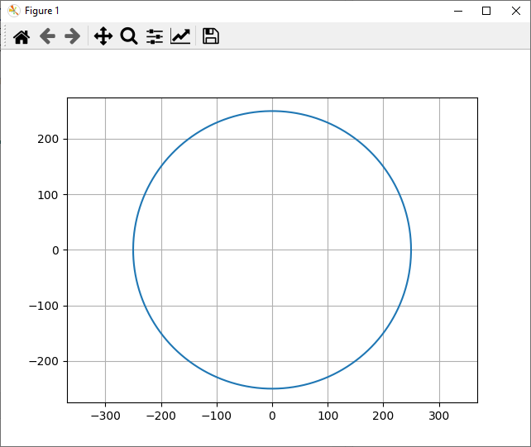
Run plot_circle.py

Slide 40

Drawing the Olympic Rings
x_offset
(0,0)
y_offset
x_offset / 2

Slide 41
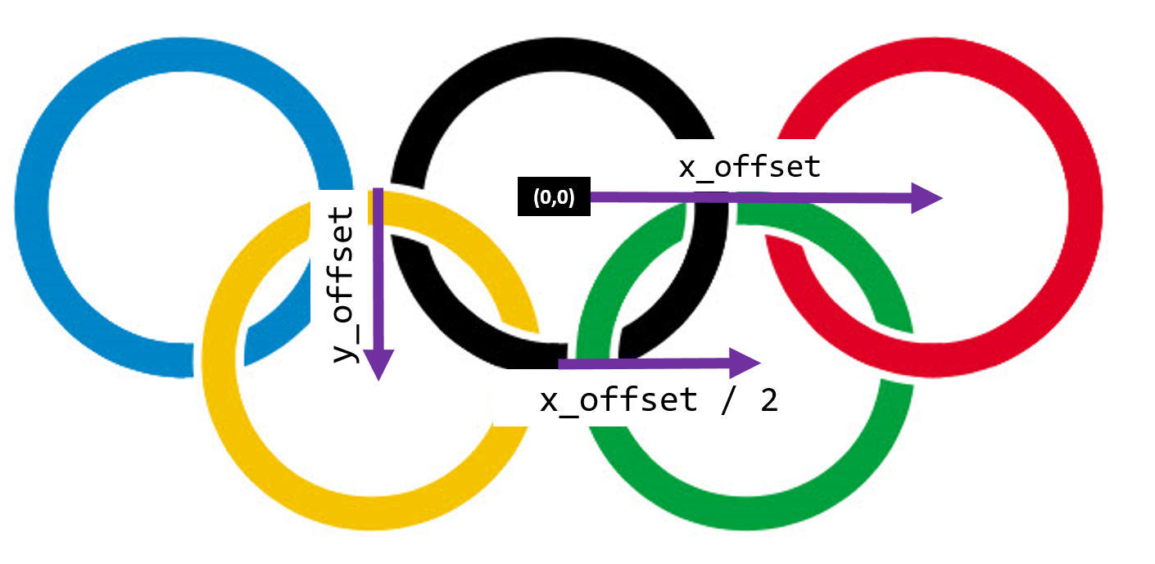
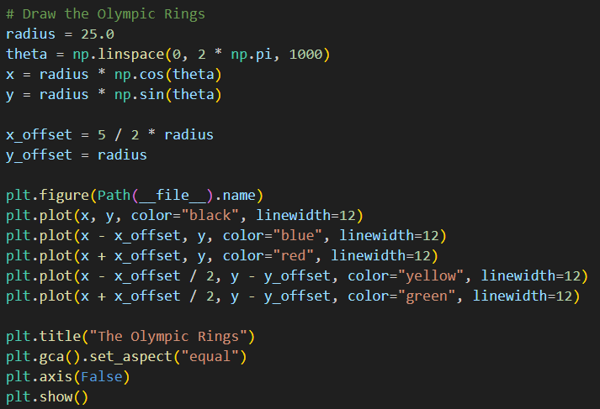
Open plot_rings.py
①
②
③
④
⑤

Slide 42

Run plot_rings.py
☺

Slide 43
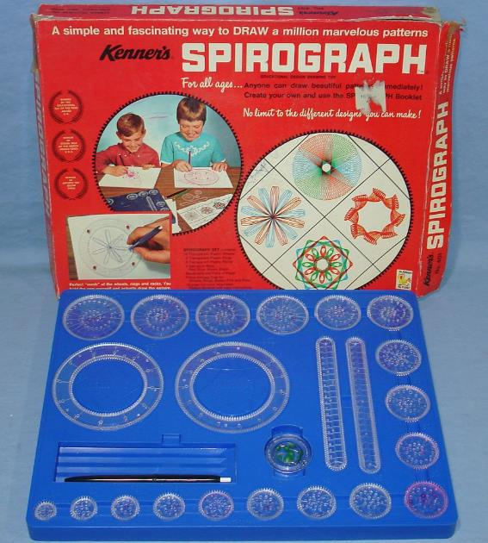
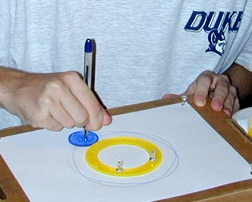
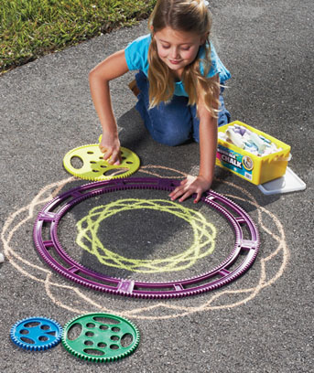

Parametric Curves

Slide 44
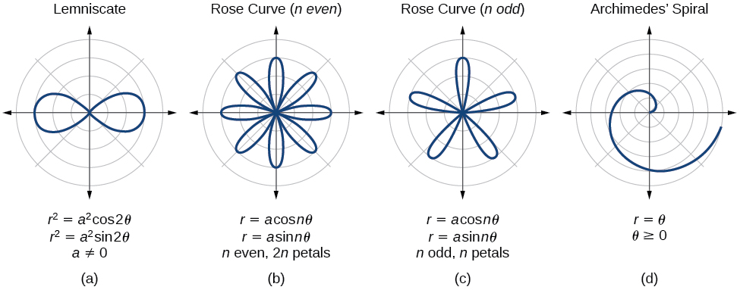
Parametric Curves
The two parameters a, n are used to calculate the current radius $r$ as $θ$sweeps the circle

Slide 45
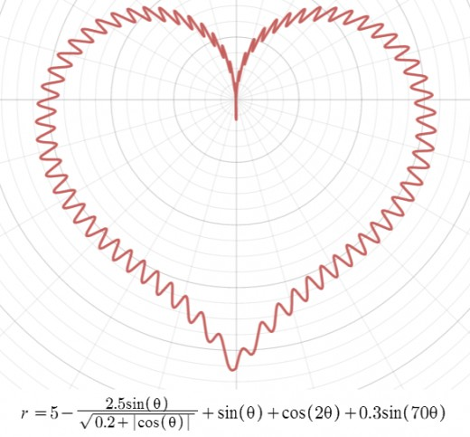
Parametric Curves

Slide 46
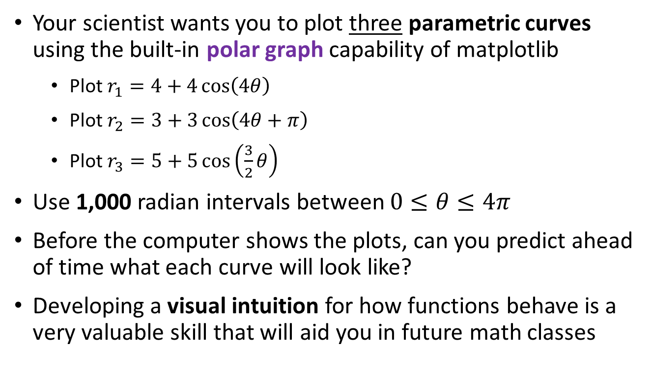
Parametric Curves Using Polar Graphs
Your scientist wants you to plot three parametric curves using the built-in polar graph capability of matplotlib
Plot $r_{1}=4+4\cos\left(4θ\right)$
Plot $r_{2}=3+3\cos\left(4θ+π\right)$
Plot $r_{3}=5+5\cos\left(\frac{3}{2}θ\right)$
Use 1,000 radian intervals between $0≤θ≤4π$
Before the computer shows the plots, can you predict ahead of time what each curve will look like?
Developing a visual intuition for how functions behave is a very valuable skill that will aid you in future math classes

Slide 47
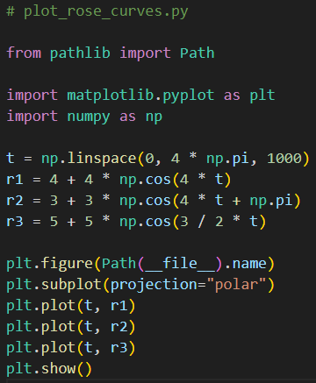
Open plot_rose_curves.py
①
②
③
④
⑤

Slide 48
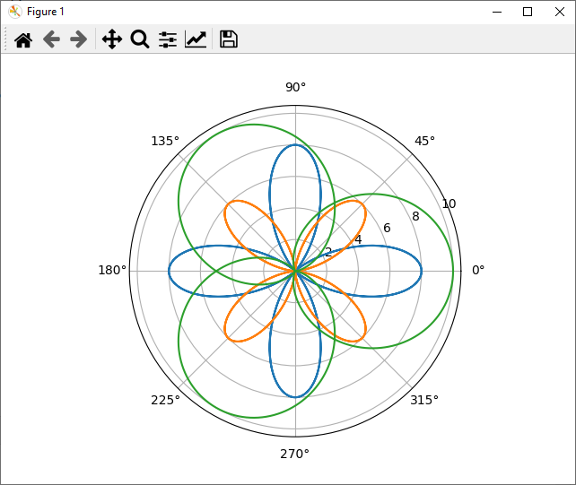
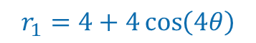


Run plot_rose_curves.py
$$r_{1}=4+4\cos\left(4θ\right)$$
$$r_{3}=5+5\cos\left(\frac{3}{2}θ\right)$$
$$r_{2}=3+3\cos\left(4θ+π\right)$$

Slide 49

The Superposition of Waves
Even just two simple sinusoids (waves) when placed in superposition (added together) can produce very complicated results
There is a trigonometry identity called the "angle product formula" that allows us to represent the superposition of two sinusoids as the product of their respective wave functions
Your scientist wants to study the behavior of this superposition: $r=7+7\sin\left(11θ\right)cos\left(5θ\right)$
Plot $r_{4}$ with a black pen over the interval $0≤θ≤4π$

Slide 50





Open plot_superposition.py
$$0≤θ≤4π$$
①
②
③
$$r=7+7\sin\left(11t\right)\cos\left(5t\right)$$
Angle Product Identity
$$\sin{θ}\cos{φ}=\frac{\sin\left(θ+φ\right)+\sin\left(θ−φ\right)}{2}$$
$$7+7sin{11t}\cos{5t}=7+\frac{7}{2}\left[\sin\left(16t\right)+\sin\left(6t\right)\right]$$
Superposition

Slide 51


Run plot_superposition.py
$$7+7∗\frac{\left[\sin\left(16θ\right)+\sin\left(6θ\right)\right]}{2}$$
Even just two simple waves when added together can produce complicated results!

Slide 52


Parametric Curves
Field Induced Polarization of Dirac Valleys in Bismuth*
$$r=\sin^{2}\left(\frac{6}{5}θ\right)+\cos^{2}\left(\frac{6}{1}θ\right)$$
*Bismuth is the element with the highest atomic mass that is stable

Slide 53
Temperature Conversion
Your scientist has asked you to plot the Fahrenheit and Celsius temperature equivalents for temperatures in Kelvin that span from 0K to 400K inclusive
Your plot should label the line graph of each temperature scale and show a legend to ease plot comprehension
As with all professional graphs, each axis should be labeled with the appropriate units
The graph should have a title and a grid for easier reading of the values
The research question is, "What is the one temperature that is the same in Fahrenheit and Celsius?"

Slide 54

Open fahrenheit_to_celsius.py
①
②
③
④
⑤
⑥
⑦
⑧

Slide 55


Run fahrenheit_to_celsius.py
$${−40}^{°}$$
What is the one temperature that is the same in Fahrenheit and Celsius?

Slide 56


How did we calculate absolute zero in 1779? (PV = nRT)

Slide 57


Infinite Series (Sums)
Recall the harmonic series
$$y_{1}=\sum_{n=1}^{∞}{\frac{1}{n}=1+\frac{1}{2}+\frac{1}{3}+\frac{1}{4}+\frac{1}{5}+\frac{1}{6}+\frac{1}{7}+…}$$
Recall the Basel series
$$y_{2}=\sum_{n=1}^{∞}{\frac{1}{n^{2}}=1+\frac{1}{4}+\frac{1}{9}+\frac{1}{16}+\frac{1}{25}+\frac{1}{36}+\frac{1}{49}+…}$$

Slide 58




Open basel_problem.py
$$n→100,000$$
①
$$y_{1}=\sum_{n=1}^{∞}{\frac{1}{n}}$$
②
③
④
$$y_{2}=\sum_{n=1}^{∞}{\frac{1}{n^{2}}}$$
⑤
⑥
⑦

Slide 59



Run basel_problem.py
The harmonic series diverges slowly towards $∞$
$$\frac{π^{2}}{6}=1.6449…$$
The Basel series converges to a specific number

Slide 60
Session 06 – Part 3 of 3 – Topics
Perform experimental computation mathematics by simulating the Collatz Conjecture and visualizing its probability distribution
Plot the trajectory of a random walk taken on a free (unconstrainted) 2D plane
Use linear regression (Gauss’ method of least squares) to empirically determine the expected final distance of a random walk on a fixed 2D lattice
Visualize the Euler Line for random triangles and appreciate the Radon Projection to simplify the rendering of complicated diagrams involving computational geometry

Slide 61

The Collatz Conjecture
First proposed in 1945 by Lothar Collatz, it remains unsolved
Take any positive integer n
If n is even, divide it by 2
If n is odd, multiply it by 3 and add 1
Repeat the process until n reaches 1
The conjecture is that no matter what integer you start with the process will always reach 1
It is maddening simple to state, but no one has been able to prove this claim is either true or false!
What is the sequence for 26 ?

Slide 62
The Collatz Conjecture
26
13
40
20
10
5
16
8
4
2
1
If n is even, divide it by 2
If n is odd, multiply it by 3 and add 1
Repeat the process until n reaches 1
What is the sequence for 26 ?
What is the sequence for 27 ?
26 took 10 steps to reach 1

Slide 63


The Collatz Conjecture
Step Value
Step Count

Slide 64

Stopping Time
The stopping time (for a given integer n) is the total number of Collatz iterations before reaching 1
This specific graph shows the stopping times for n < 10,000
Stopping times appear to exhibit a rough pattern, but we have no formula to accurately predict it for any n
Stopping Time
Increasing n

Slide 65

Frequency of Stopping Times
We are interested in analyzing the frequency (count) of each stopping time for n < 1,000,000
What is the overall shape of the distribution of stopping times?
We will use a histogram to display the count of each stopping time
Your task is to implement the stopping time function:

Slide 66

Open collatz_conjecture.py
⑤
Python's Ternary Operator
⑥
⑦
⑧
①
②
③
④
⑨
⑩

Slide 67


Run collatz_conjecture.py
Would you have guessed the stopping time distribution takes this shape?

Slide 68

Random Walks
Your scientist wants you to create a Python program to display the 2D Cartesian plot of a meandering walker
The walker starts at the (0,0) origin and takes one step at a time
At each step, the walker picks a random angle (uniform distribution) within the interval $[0,2π)$ and moves (from his current position) one unit of distance in that radial direction
Your boss wants your program to show the entire journey of 10,000 random steps in your plot
On average, how far away (Pythagorean distance) from the start point will the walker stop?

Slide 69



Open random_walk.py
①
②
③
④
⑤
⑥
⑦
⑧
$$ⅆx$$
$$ⅆy$$
⑨
⑩

Slide 70



Run random_walk.py
Average final distance = $\sqrt{n}$
Stop
Start
Albert Einstein
(1879 – 1955)

Slide 71


Robert Brown
(1773 – 1858)

Slide 72


Slide 73
Uniform Random Walk on 2-D Unit Lattice
Suppose the walker is constrained to taking unit steps in the four cardinal directions, forcing the walk to traverse only the integer (lattice) coordinates of a 2-D grid
Imagine each walk starts at the origin (0,0) and that the total steps for each walk can vary from 1 to 200
As a function of the number of steps taken, how far away from the origin (using Cartesian straight-line distance) will the average walk end?
We will take 50,000 walks of each length (1 to 200) and compute the average final Euclidian distance from the origin

Slide 74

Open random_walk_lattice.py
①
②
③
④
⑤

Slide 75



View random_walk_lattice.py
①
②
③
④
dims=2 for a 2D Grid:
Either a vertical $\left(Δy\right)$ or horizontal $\left(Δx\right)$step
⑤
h=0 : horizontal $\left(Δx\right)$step
h=1 : vertical $\left(Δx\right)$step
⑥
⑦
⑧
⑨
⑩

Slide 76
View random_walk_lattice.py
①
②
③
④
⑤
⑥
⑦
⑧

Slide 77



View random_walk_lattice.py
①
②
③
④
⑤
⑥
⑦
Carl Friedrich Gauss
(1777-1855)

Slide 78

View random_walk_lattice.py
①
1 | 2
②
③
④
1 | 2
⑤
⑥
⑦
⑧
⑨
⑩

Slide 79






Run random_walk_lattice.py
$$slope×4=\frac{{\left(d_{avg}\right)}^{2}}{n}×4=π$$
$$slope=\frac{{\left(d_{avg}\right)}^{2}}{n}$$
For a walk on a fixed lattice
$$d_{avg}=\frac{\sqrt{πn}}{2}$$
$${\left(d_{avg}\right)}^{2}=\frac{π}{4}n$$
$$n=\# of steps$$

Slide 80


The Euler Line
Centroid = center of mass
Circumcenter = intersection of $⊥$ side bisectors
Orthocenter = intersection of the altitudes
The Euler Line gives a unique statistical fingerprint for a triangle and is used in facial image recognition algorithms

Slide 81

The Euler Line

Slide 82


Open euler_line.py
A dataclass is like a struct in "C/C++" (a class with no methods/member functions)
①
②
⑤
③
A Radon Line
④

Slide 83




The Radon Projection
The classic equation for a line: $y=mx+b$ cannot readily represent a vertical line since neither of the two available unknowns $(m,b)$ are coefficients of the $y$ term
The Radon projection is an equation also having only two unknowns $\left(θ,d\right)$ but it can represent all lines, including both horizontal and vertical lines
$$x\cos{θ}+y\sin{θ}=d, where \left\{θ,d∈ℝ\right\}$$
$$and −∞≤d≤∞, 0≤θ<π$$
$$x=7 ?$$
At $θ=0$ we can make the $y$ term “disappear”
At $θ=\frac{π}{2}$ we can make the $x$ term “disappear”

Slide 84




Johann Radon
(1887 – 1956)
Why care about the “Radon” transform?
Because it is the basis for all CAT and PET scans in the medical field
It is also the foundation for computer vision in autonomous vehicles and fingerprint recognition

Slide 85

View euler_line.py
①
②
③
④
⑤
⑥
⑦

Slide 86

View euler_line.py
①

Slide 87

View euler_line.py
①
②
When working in a new "geometry" build up a toolbox of common operations:
Find the line between two points
Find the point where two lines intersect
Find the line tangent to another line that passes through a given point

Slide 88

Run euler_line.py

Slide 89

Set prng_seed = 2019
①

Slide 90

Run euler_line.py

Slide 91
The Incenter
The Incenter falls on the Euler Line only in isosceles triangles

Slide 92

Set prng_seed = 2020
①

Slide 93

Run euler_line.py

Slide 94

Intersection of Radon Projection and Circle
$$x\cos{θ}+y\sin{θ}=d∩x^{2}+y^{2}=r^{2}$$
Find Cartesian $\left(x,y\right)$ intersection point

Slide 96
Session 06 – Now You Know…
The package matplotlib, and its pyplot collection of functions, make Python work like MATLAB
You get a reference to a figure which contains axes and you do most things with the axes
Always size (domain and range) and decorate your plots with appropriate labels
Be mindful when drawing circles to maintain proper plot aspect ratio when rendering on a rectangular screen
The package sympy enables Python code to do symbolic math just like Mathematica
Learn LaTeX – all professional publishers expect science papers to be submitted using LaTeX, not MS Word

Slide 97
Session 06 – Now You Know…
The Collatz Conjecture is yet another unsolved problem in number theory which is so easy to state, but so hard to prove
We know the shape of the distribution changes significantly as you analyze higher values of n – it approaches a Poisson distribution, but we don’t know the parameters
This is an excellent example of experimental computation mathematics – the computer can find the stopping time for a million integers in just a few seconds
After extensive calculations, scientists search for patterns in the data, ultimately trying to find analytic expressions that describe the underlying natural law – consider the random walk experiment

Slide 98

Task 06-01
Create a Python program called plot_ellipse.py that displays the full 2D graph of an ellipse having these parameters:
A major axis of length 100 (along the x-axis)
A minor axis of length 50 (along the y-axis)
Centered at the origin
First, calculate the points on the perimeter of the ellipse using polar coordinates
Sweep $θ$ through the interval $[0,2π)$
Then find the radius at each $θ$ using a formula that converts the Cartesian coordinates for an ellipse into polar coordinates
Second, convert the theta and radius arrays to Cartesian coordinates and graph them using a line plot
Upload your solution to the BNL QIS102 SharePoint site

Slide 99

Task 06-01

Slide 100

Task 06-02
Create a Python program called random_walk_gamma.py that plots the expected final distance $𝔼\left(dist\right)$of a uniform random walk of $N$ steps on a unit lattice having dimension $d$
Use the following formula to calculate that expected (mean) value of the final distance from the origin for dimension $d$ where $Γ\left(x\right)$ is Euler's Gamma function and $N$ is the number of steps:
$$𝔼\left(dist\right)=\sqrt{\frac{2N}{d}}{\left(\frac{Γ\left(\frac{d+1}{2}\right)}{Γ\left(\frac{d}{2}\right)}\right)}^{2}$$
Evaluate $𝔼\left(d\right)$ for $1≤d≤25 (d∈ℝ^{+})$ not just for $(d{∈ℤ}^{+})$ with the number of steps $N=20,000$
Upload your solution to the BNL QIS102 SharePoint site

